Slide 1
Bromide
in the environment
Tanner Schulze & Natalie Hanson
Toxicology
May 2, 2015

Slide 2

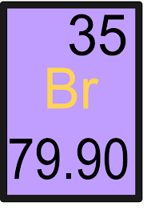

Definition
A negatively charged bromine atom creates Bromide
It is a halide that competes for the same receptors used in the thyroid gland to capture iodine
This inhibits thyroid hormone production resulting in a low thyroid state

Slide 3
Background
Bromide was previously used in over the counter sedatives and as a headache remedy (ie. potassium bromide, lithium bromide)
In 1930-40s Bromide was used in sleep aids, anti-epilepsy drugs and commonly used drugs such as Aspirin
In 1975 Bromide was withdrawn from these medications due to chronic toxicity
It has been banned in the form of food in the UK (1990) & Canada and Brazil (1994)
Unfortunately, bromide is still used for food as well as other products in America

Slide 4

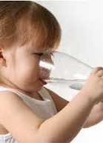
Administration
Ingestion
Drinking water
Contaminated foods
Inhalation
Bromine gas fumes
Bromide is heavier than air, settles in low-lying areas
Skin exposure
Direct contact with liquid or gas

Slide 5

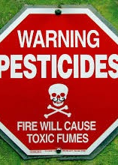
Exposure
Pesticides- via methylbromide
Predominately in CA region on strawberries
Soft Drinks- Mountain Dew, Sun Drop, Squirt, Fresca, Gatorade
Brominated vegetable oil (BVO) added to citrus drinks to suspend flavor
Bakery products and flours- via potassium bromate
Plastics & Fire retardants
Fabrics, carpets, upholstery, mattreses, automobiles
Personal Care Products
Hair dyes, textile dyes, preservatives in cosmetics
Anesthesia- via “Halothane” agent
Will increase bromide levels 2-3 days post anesthesia

Slide 6

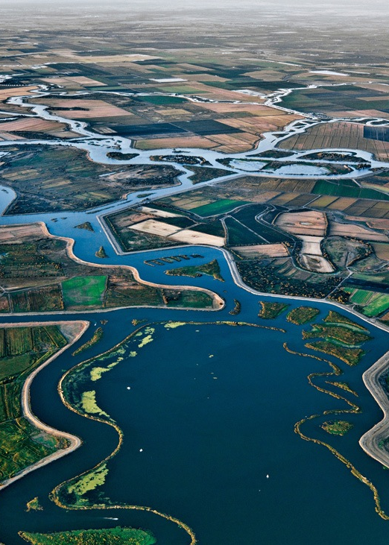
Water Supply
San Joaquin Delta serves 22 million people in Bay-Delta region & Southern California
Disinfection of water is critical (Chlorine), however byproducts pose many other health risks.
If bromine is present in the water supply, it reacts with Cl- creating harmful byproducts
Disinfection Byproducts- Brominated THMs
dibromochloromethane
bromodichloromethane
bromoform
An increase in pH increases bromate formation
Ozonation increasingly used for disinfection of drinking water, leads to the formation of Hypobromite and when oxidized forms Bromate

Slide 7

Statistics
International Agency for Research on Cancer has sufficient evidence that Bromide is carcinogenic
However, USEPA has established a maximum contaminant level of .1 mg/L for bromate in drinking water
Contaminate levels less than the allowable levels have been shown in cross-sectional studies to produce serious birth defects
Adverse Reproductive Outcome | Disinfectant By-product Levels | Odds Ratio (Relative Risk)
Low term birth weight | >0.080 mg/L | 1.34
Birth defects (overall) | >0.080 mg/L | 1.53
CNS defects | >0.080 mg/L | 2.6
Neural tube defects | >0.080 mg/L | 2.98
Cardiac defects | >0.080 mg/L | 1.44

Slide 8

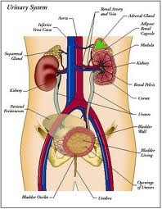
Physiology
Excreted by Kidneys
Half life: 12 days
VERY long compared to other pharmaceuticals
Bromine displaces iodine by competing with iodine receptors
Leading to an iodine deficiency & hypothyroidism
This creates an increased risk for breast, thyroid, ovary and prostate cancer
This phenomenon is known as the Bromide Dominance Theory

Slide 9

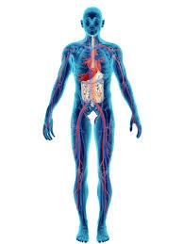
Physiology
Bromide builds up in the Central Nervous System and results in many issues
It acts like a depressant in the CNS and can trigger a number of psychological symptoms (ie. acute paranoia)
Other physiological symptoms of bromide include
Skin rashes & severe acne
loss of appetite & abdominal pain
Fatigue
Metallic tase
Cardiac Arrythmias

Slide 10
Bromism
Bromism is a condition encompasses multiple neurological symptoms caused by bromide toxicity
Psychiatric
Self neglect
Fatigue
Impairment of memory and concentration
Emotional instability & irritability
Depression
Can profess to schizophrenic like behavior
Neurological
Headache
Tremor
Slurred speech
Spontaneous movements
Incoordination/Ataxia
Tendon reflex change
Pathological reflexes
Photophobia, blurred vision, mydriasis, ptosis
Dermatological/ “Bromoderma”
Papular eruption of face & hands
Macular rash
Abnormal pigmentation
Especially with sun exposure

Slide 11
Treatment
STOP EXPOSURE
Saline Loading
Large quantities of Sodium Chloride diluted in water & injected into the veins
This process enhances excretion of bromide by kidneys
Reduces half life from 12-14 days to 65 hours
If ineffective, hemodialysis is necessary
Reduces half life from 12-14 days to 1.65 hours

Slide 12

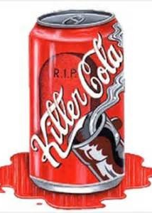
Cola Case Study
Prior to1997, toxic bromism was a unusual occurrence
A case study conducted in UC Davis, male patient presented with headache, fatigue, ataxia, ptosis and memory loss
He consumed 2-4L of cola per day
Cola currently contains BVO
Toxicity levels were so high, saline loading was ineffective
Hemodialysis was necessary to clear his condition

Slide 13

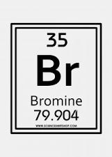
Key Points
Bromide is a halide that competes for iodine receptors and leads to low thyroid function
Used in many medications in US, banned in 1975
Still used in foods & products in US
Found in drinking water, pesticides, sodas, flours & baked products, cosmetics, flame retardants
Harmful by-product of water disinfection
Has been found to be carcinogenic
Long half life 12 days
Psychiatric, neurological, and dermatomal effects
Treatment through saline loading, or hemodialysis in extreme cases

Slide 14
Resources
“Bromines: Avoid This if You Want to Keep Your Thyroid Healthy”. Mercola.com. http://articles.mercola.com/sites/articles/archive/2009/09/05/another-poison-hiding-in-your-environment.aspx.
Centers For Disease Control And Prevention. "Model Aquatic Health Code Disinfection and Water Quality Module ANNEX Draft Sections for the First 60‐day Review." Disinfection and Water Quality MAHC ANNEX Draft Posted For Public Comment 02-27-2012 (n.d.): n. pag. Center for Disease Control and Prevention. Web
"Case Definition: Bromine Poisoning." CDC Bromine. Center for Disease Control and Prevention, n.d. Web. 19 Feb. 2015.
Chen Wei-hsiang, Haunschild Kristine, Lund Jay. “Delta Drinking Water Quality and Treatment Costs: Technical Appendix. Public Policy Institute of California. Sept. 2008.
Heeb, Michele, Crique, Justine, Zimmermann, Saskia and Von Guten, Urrs. “Oxidative treatment of bromide-containing waters formation of bromine and its reactions with inorganic and organic compounds: A critical review” Water Research (n.d.): pag. Web.
Horowitz, B. Zane. “Bromism from excessive cola consumption.” Clinical Toxicology 35.3 (1997):315-320.
Liu, Chao, Von Gunten, Urrs, and Jean-Philippe, Croue. "Chlorination of Bromide-containing Waters: Enhanced Bromate Formation in the Presence of Synthetic Metal Oxides and Deposits Formed in Drinking Water Distribution Systems." Water Research (n.d.): n. pag. Web.
“Revisions to the Unregulated Contaminant Monitoring Regulation (UCMR 3) for Public Water Systems” Federal Register: The Daily Journal of the United States Government. 2012.
World Health Organization. "Bromide in drinking-water: background document for development of WHO guidelines for drinking-water quality." (2009).

